Slide 1
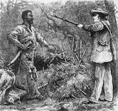
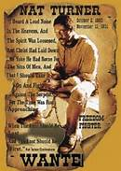
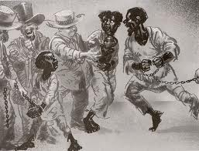
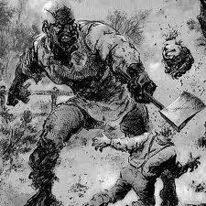
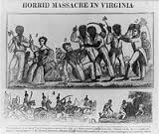
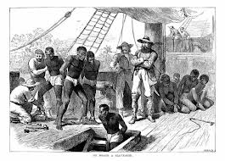
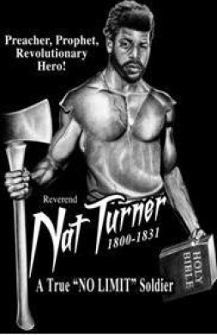
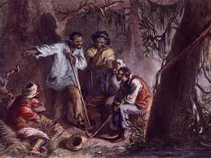
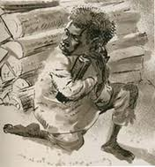
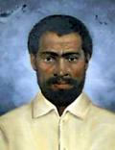
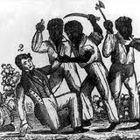
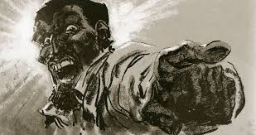
Nat Turner - 1831

Slide 2
Nat Turner
Why was Nat Turner important during the Civil War?
Was an American Slave (1831) that led a slave rebellion in Virginia that resulted in 55 white deaths and more than 100 black deaths. Turner was captured, convicted, and sentenced to death by hanging.

Slide 3
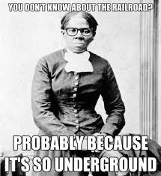
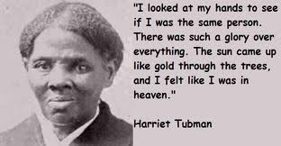
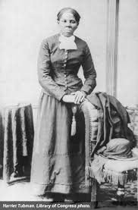
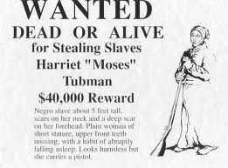
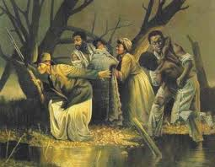
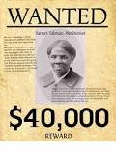
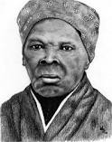
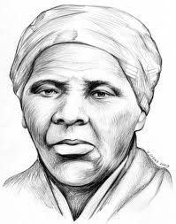
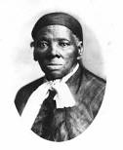
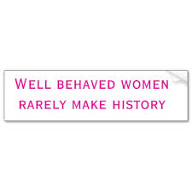
~HARRIET TUBMAN/UNDERGROUND RAILROAD~

Slide 4
Harriet Tubman/Underground Railroad
Why was Harriet Tubman/Underground Railroad important during the Civil War?
Former slave that used the Underground Railroad, a network of anti-slave activists and safe houses that helped slaves escape to freedom. She made 19 trips that rescued more than 300 slaves. (@1840’s)

Slide 5
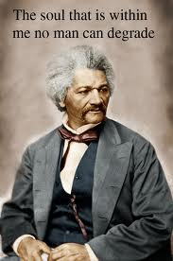
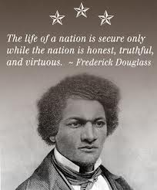
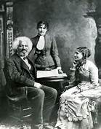
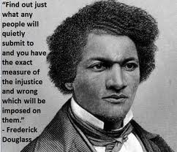
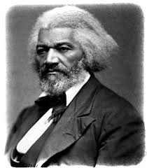
Frederick Douglass

Slide 6
Frederick Douglass
Why was Frederick Douglass important during the Civil War?
After escaping slavery he became a leader of the Abolitionist movement by giving inspiring speeches and writing against slavery. He was the Voice of Anti-Slavery Movement. @1840’s

Slide 7
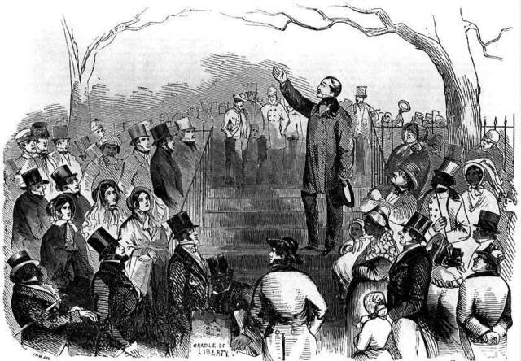
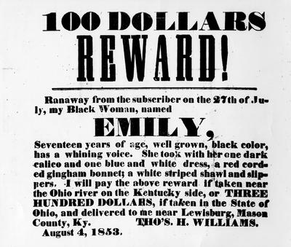
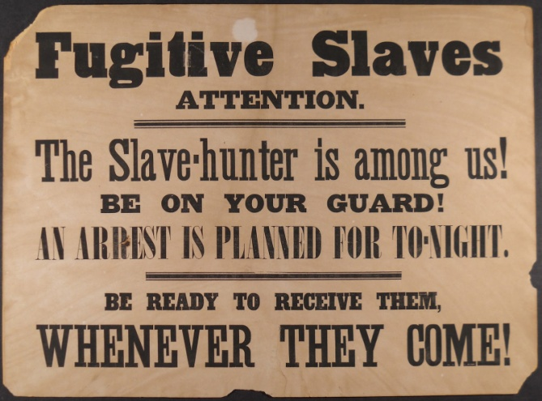
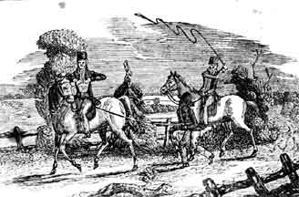
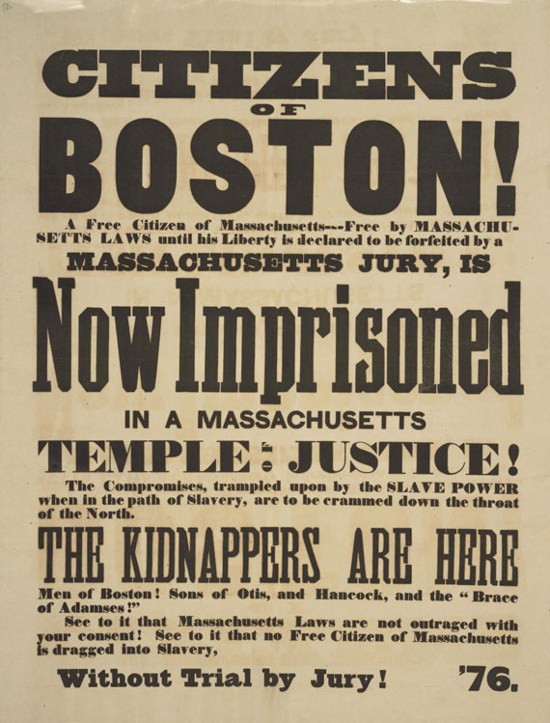
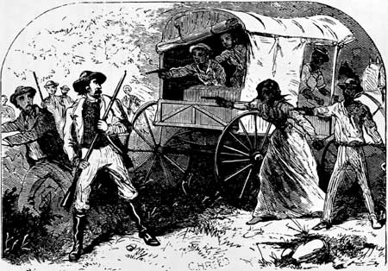
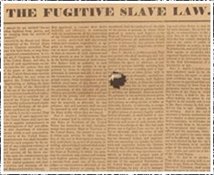
The
Fugitive
Slave Act

Slide 8
Fugitive Slave Act
Why was Fugitive Slave Act important during the Civil War?
1850 Law that allowed slave owners to recapture runaway slaves. The law resulted in many free blacks being recaptured and sold back into slavery, which angered northerners.
It provided another reason to abolish slavery. (Movie 2013: 12 Years A Slave)

Slide 9
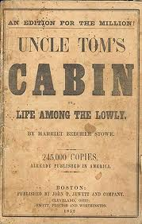
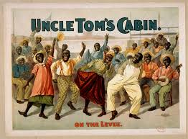
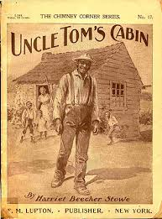
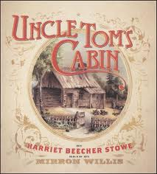
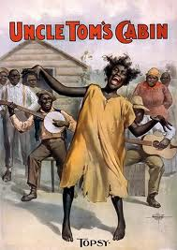
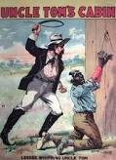
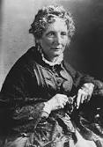
UNCLE TOM’S CABIN

Slide 10
Uncle Tom’s Cabin
Why was Uncle Tom’s Cabin important during the Civil War?
Famous Novel that portrayed slavery as brutal and immoral. Convinced (white) people that slavery was wrong. A written document that spoke out against slavery.
(ie.Like the movie The Help)

Slide 11
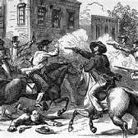
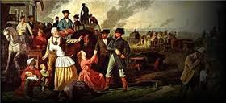
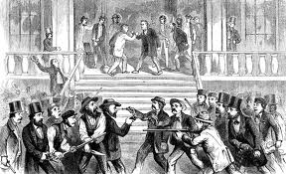
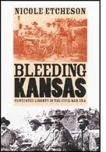
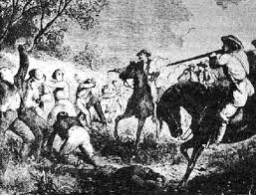
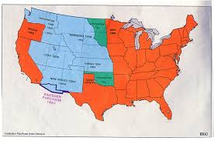
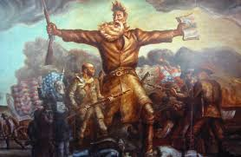
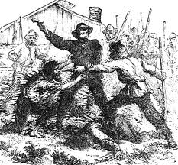
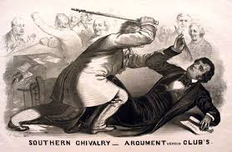
Bleeding Kansas

Slide 12
Bleeding Kansas
Why was Bleeding Kansas important during the Civil War?
Nickname given to the fighting between pro-slavery and anti-slavery settlers in Kansas that resulted in many deaths. It Proved that compromise over slavery was unlikely so War would have to solve it.

Slide 13
Dred Scott Supreme Court Decision

Slide 14
Dred Scott Supreme Court Decision
Why was the Dred Scott Supreme Court Decision important during the Civil War?
Supreme Court case where a former slave sued for his freedom and lost. Court ruled that African Americans were not citizens, they were property, and had no right to sue. Court also ruled congress had no right to prohibit Slavery. Major setback for anti-slavery movement

Slide 15
Harper’s Ferry Raid
John Brown

Slide 16
Harper’s Ferry Raid/John Brown
Why was the Harper’s Ferry Raid/John Brown important during the Civil War?
An unsuccessful attempt by abolitionist John Brown to start an armed slave revolt in 1859 by seizing an U.S. Weapons Arsenal at Harpers Ferry, Virginia. Brown was captured, convicted of Treason, and hanged.

Slide 17
Abraham Lincoln Elected President

Slide 18
Abraham Lincoln Elected President
Why was the Abraham Lincoln Elected President important during the Civil War?
Lincoln’s victory angered the South, and led to the secession of the Southern States. The South believed he would destroy their way of life by taking away their states rights to own slaves.

Slide 19
South Carolina Secedes

Slide 20
South Carolina Secedes
Why was South Carolina Seceding
important during the Civil War?
In 1860 South Carolina was the 1st state to secede from the Union. Reason- To protect their states rights to maintain the institution of slavery. S.C. influenced other states to follow.

Slide 21
The Confederate States of America Are Formed

Slide 22
The Confederate States of America is Formed
Why was the forming of The Confederate States of America important during the Civil War?
The CSA formed their own country in 1861 in order to preserve slavery, political freedom, and their States Rights. 11 Southern States made up the CSA. This group of Southern States becomes the opposing side in The Civil War.

Slide 23
Jefferson Davis

Slide 24
Jefferson Davis
Why was Jefferson Davis important during the Civil War?
He served as the President of The Confederate States of America during the Civil War 1861-1865.

Slide 25
Northern Uniforms and Flags

Slide 26
Northern Uniforms and Flags
Why were Northern Uniforms and Flags
important during the Civil War?
Soldiers during the Civil War strongly believed they represented their home states. Each state had its own flag. Soldiers took a great deal of pride in their states flag. New York, Pennsylvania, Ohio, etc were Northern States, Uniforms were Blue. Flags were variations of U.S. flag at the time.

Slide 27
Southern Flags and Uniforms

Slide 28
Southern Flags and Uniforms
Why were Southern Flags and Uniforms important during the Civil War?
See Northern Flags and Uniforms information. Southern Uniforms were Gray. Flags were variations of the rebel flag.

Slide 29
Weapons Used in the Civil War

Slide 30
Weapons Used in the Civil War
Why were Weapons Used in the Civil War important during the Civil War?
Soldiers on both sides used swords, knives, pistols, rifled muskets, and cannons. Little had changed since the American Revolution with the exception of a new bullet called the “Minnie Ball”.

Slide 31
The South Attacks Fort Sumter

Slide 32
The South Attacks Fort Sumter
Why was The South Attacking Fort Sumter important during the Civil War?
The Southern attack on Fort Sumter (April 12-14, 1861) near Charleston, South Carolina is the event that began the Civil War. Result – Southern Victory – No casualties on either side.

Slide 33
AMPUTATIONS

Slide 34
Amputations
Why were Amputations important during the Civil War?
The most common surgical procedure used during the Civil War was amputations. Bullet wounds were certain to become infected. Amputations, removing of limbs, was the only way to save lives.

Slide 35
General Robert E . Lee

Slide 36
General Robert E. Lee
Why was General Robert E. Lee important during the Civil War?
Was the leading General of the Confederate Army during the Civil War. He was from Virginia. He chose to fight for the South even though he was against slavery, he did not want to fight against Virginia. He was the Commander at Gettysburg. By far the most beloved General of the war on either side.

Slide 37
The First Battle of Bull Run

Slide 38
The First Battle of Bull Run
Why was The First Battle of Bull Run important during the Civil War?
AKA First Manassas was fought on July 21, 1861 near the city of Manassas, Virginia. It was the first major land battle of the Civil War. Result – Confederate Victory.

Slide 39
The Battle of Antietam

Slide 40
The Battle of Antietam
Why was The Battle of Antietam important during the Civil War?
Fought on September 17, 1862 in Maryland. Was the Bloodiest single day battle in American History. More than 22,000 dead, wounded or missing. Result – Union victory.

Slide 41
Ironclad Battleships (Monitor and Merrimack)

Slide 42
Ironclad Battleships (Monitor and Merrimack)
Why were Ironclad Battleships (Monitor and Merrimack) important during the Civil War?
Ironclads were steam powered warships protected by iron or steel. The Monitor (Union) vs. The Merrimack (Confederate) fought in the 1st ever sea battle of Ironclad battleships. Result – Inconclusive – a tie.

Slide 43
Emancipation Proclamation

Slide 44
Emancipation Proclamation
Why was the Emancipation Proclamation important during the Civil War?
EP was an executive order issued by Lincoln in 1863 that proclaimed all African American slaves to be forever free. Added @ 200,000 more troops to the Union Army. Leads to Union Victory.

Slide 45
The Battle of Gettysburg

Slide 46
The Battle of Gettysburg
Why was the The Battle of Gettysburg important during the Civil War?
Fought from July 1-3, 1863 in Gettysburg, Pennsylvania. It was the battle with the largest number of casualties during the Civil War. More than 46,000 dead, wounded, captured or missing. Result – Union Victory. Turning Point of the war.

Slide 47
Sherman Captures Georgia

Slide 48
Sherman Captures Georgia
Why was Sherman Capturing Georgia
important during the Civil War?
From November 15 – December 21, 1864 General William T. Sherman of the Union Army invaded and captured Georgia. He destroyed, burned and crushed military targets, industry, and property all throughout Georgia without mercy. (Clark Gable- Gone With The Wind) Result – Union victory demoralized the South’s will to fight.

Slide 49
Joshua Chamberlain

Slide 50
Joshua Chamberlain
Why was Joshua Chamberlain important during the Civil War?
J.C. was A college professor from Maine (20th Maine Regiment) that volunteered to join the Union Army as an officer during the Civil War. Won the Medal of Honor at The Battle of Gettysburg for his bravery and courage defending Little Round Top.

Slide 51
George B. McClellan

Slide 52
George B. McClellan
Why was George B. McClellan important during the Civil War?
Was a leading General of the Union Army during the Civil War. Served briefly as the Chief General until Lincoln replaced him for not pursuing Lee after the Union Victory at Antietam.

Slide 53
Appomattox Court House Surrender

Slide 54
Appomattox Court House Surrender
Why was the Appomattox Court House Surrender important during the Civil War?
On April 8, 1865 Confederate General Robert E. Lee surrendered to Union General Ulysses S. Grant at Appomattox Court House, Virginia ending the Bloodiest War in American History.

Slide 55
General Ulysses S.
Grant

Slide 56
General Ulysses S. Grant
Why was General Ulysses S. Grant important during the Civil War?
U.S. Grant was the most successful Union General during the Civil War. After the war he would become our (Ohio) 18th President.

Slide 57
Northern & Southern KIA

Slide 58
Northern & Southern KIA
Why were Northern & Southern KIA
important during the Civil War?
North South
KIA @140,000 @72,000
Total Dead @365,000 @260,000
WIA @275,000 @137,000
Total Both Sides = @615,000

Slide 59
Lincoln is assassinated

Slide 60
Lincoln is Assassinated
Why was Lincoln being Assassinated
important during the Civil War?
Lincoln was assassinated on April 14th, 1865. He was the 1st American President to be assassinated. It was planned and carried out by John Wilkes Booth in order to revive the confederate cause.

Slide 61
Reconstruction of the South

Slide 62
Reconstruction of the South
Why was the Reconstruction of the South important during the Civil War?
1865-1877 is a time period in US History after the Civil War when the south was rebuilt, reorganized and readmitted to the union.

