Slide 1
Articulations

Slide 2
Chapter 11 Joints
Joints
b) Fibrous Joints
1) connections between adjacent bones
2) syndesmoses to gomphoses
3) ex.suture
c) Cartilagenous Joints
1) cartilage joins bones
2) symphysesto synchondroses
3) ex. Pubic symphasis
4) may be converted to bone →synostosis
d) Synovial Joints
1) bones seperated by joint cavity containing synovial fluid
2) know the anatomy (slide 5)

Slide 3
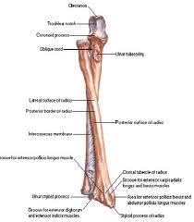
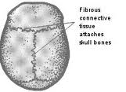
Fibrous joints
Figure 11.2 page 249 in book
Figure 11.1 page 249 in book

Slide 4
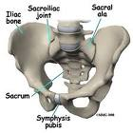
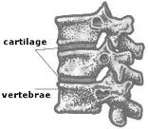
Cartilagenous Joints
Figure 11.4 page 250 in book

Slide 5
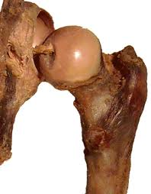
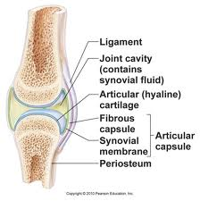
Synovial Joints
Figure 11.6 page 253 in book

Slide 6
Classification of Joints is based on anatomical structure
A. Fibrous – Articulating bone held together by fibrous tissue
1) fiberous tissue joins bones
2) immobile to slightly mobile
a. suture (in skull)
b. syndesmoses held by sheets of coll. Fibers
- found btw. radius -ulna; tibia -fibula
c. gomphoses- anchoring joint teeth and jaw
B. Cartilaginous- Articulating bone held together by cartilage
1. allows limited movement in response to twisting and compressing
2. two types
a. Symphyses -forms a pad of fibrocartilage which cushions and allows limited movement (pubic symphysis)
b. Synchodroses- costal cartilage –ribs

Slide 7
C. Synovial- Articulating bone capped with cartilage and ligaments with a fluid filled sack.
1. freely movable
2. contain synovial fluid for lubrication
3) classified by type of mobility and structure
-gliding, hinge, pivot, condyloid, saddle, ball and socket
a. gliding- movement side to side ex. Intercarpal
b. hinge- act as a hinge on a door ex. Knee, elbow
c. pivot- rotate around a axis ex. Forearm; skull, atlas
d. condyloid- angular movement in 2 directions ex. Wrist
e. saddle-shaped like a saddle with a wide range of motion ex. Opposable thumb, inner ear
f. ball and socket-multiaxial articulation, widest range of motion ex. Hip, shoulder
Diagrams p.255-256

Slide 8
Chapter 11 Joints
Joints
D.Synovial Joints
1) bones seperated by joint cavity containing synovial fluid
2) anatomy
a) joint capsule – contains synovial fluid
b) synovial membr.- tissue which secretes fluid
c) articular cartilage- hyaline cartilage
d) synovial fluid – slippery lubricant
e) meniscus- pad of cartilage between articulating bones. Absorbs shock and pressure. Distributes force.
f) accessory structures:
1)tendons , ligaments help stabilize joint; form joint capsule
2) bursae, tensheathes: synovial membrane secretes synovial fluid; lubricates, cushions.

Slide 9
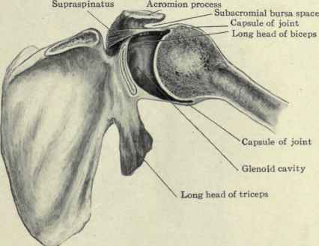

Slide 10
e. movement of synovial joints (angular)
1. flexion- decrease joint angle
dorsiflexion- elevate foot
plantarflexion- rise on toes
2. extension- opposite of flexion (180*)
hyperextension- beyond 180*
3.abduction- movement away from the body
4. adduction- opposite toward body
f. movement of synovial joints (circular)
1. rotation- movement of body part around it’s own axis. Ex shake head; twist spine
- supination- palm faces upward/forward
- pronation- palm faces backward/down
2. circumduction- rotation so a cone is traced.

Slide 11
g. movement of synovial joints (special)
1. inversion- sole of foot inward(medially)
2. eversion- sole of foot outward( laterally)
3. protraction- movement of part forward(jaw)
4. retraction- movement backward(shoulders)
5. elevation- raised body part
6. depression- lowers body part

Slide 12
Chapter 9 Joints
7. Joints
d) Synovial Joints
3) freely movable (diarthrotic)
4) arthritis – joint inflammation
a) osteoartheritis-wear and tear on the joints causing pain and inflammation
b) rheumatoid arthritis – pain & inflammation caused by an auto immune attack against joint tissues.

Slide 13
Joints to know
Shoulder p.265
Knee p.253
Hip p.269
Spine p.255
Elbow p.267

